Slide 1





ELFA GROUP
Ginyard International Co.
Global Store Analysis

Slide 2


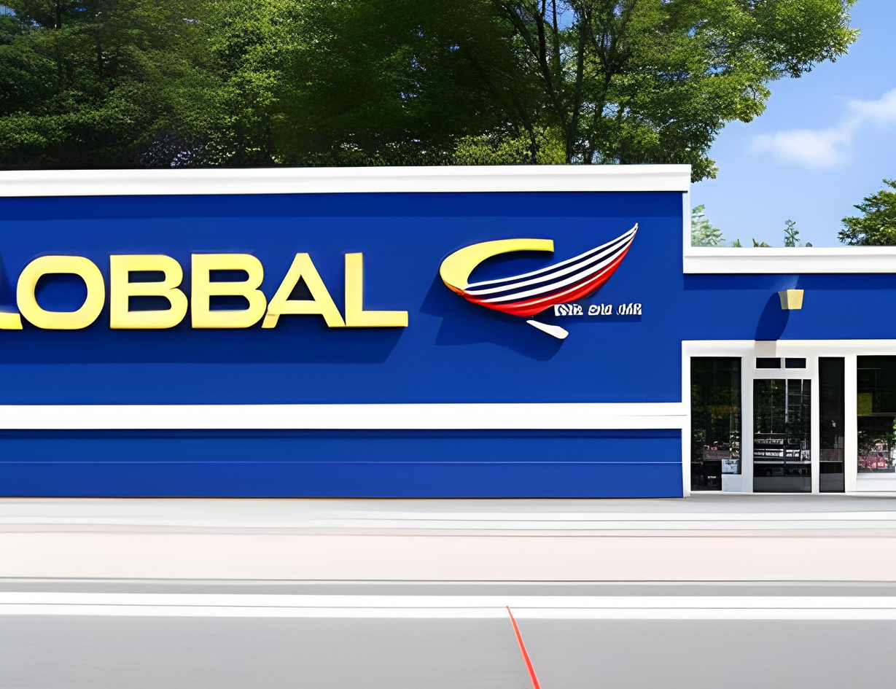
Title Page
Reporters
Introduction
Introduction
Introduction
Global Store aims to serve as a one-stop destination for diverse shopping needs.

Slide 3

Title Page
Reporters
Introduction
Introduction
Customer-Centric
Seamless and user-friendly
personalized recommendations

Slide 4

Title Page
Reporters
Introduction
Introduction
Global Accessibility
Operational Efficiency
Profitability
Segmented Approach
Innovation and Adaptation

Slide 5


Title Page
Reporters
Introduction
Goals
Goals
Goals
Customer-Excellence:
Global Accessibility:
Operational Efficiency:
Prioritizing customer satisfaction with personalized recommendations and a wide product range.
Serving diverse regions with a varied product selection.
Optimizing order processing, shipping, and inventory management for seamless operations.

Slide 6
Title Page
Reporters
Introduction
Goals
G
CONT..
Profitability and Sustainability
Segmented Approach
Innovation and Adaptation
Showcase data-driven strategies that balance customer-centricity and profitability for sustainable growth.
Explain how the Global Store tailors its offerings and marketing strategies to different customer segments, enhancing engagement and conversion rates.
Showcase the Global Store's ongoing innovation, leveraging emerging technologies for superior customer experiences and sustained competitiveness.

Slide 7
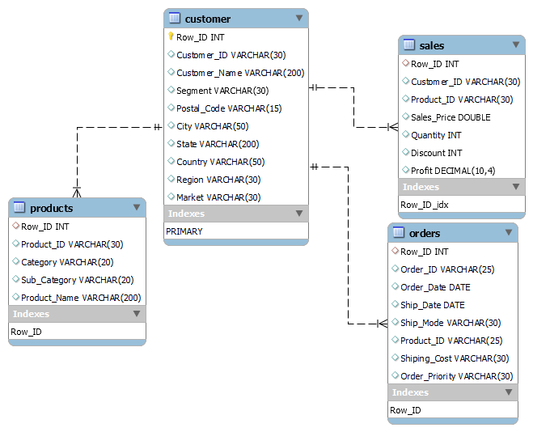
Title Page
Reporters
Introduction
Data Dictionary

Slide 8

Title Page
Reporters
Introduction
Explore Data
50
40
DATA
VISUALIZATION
30
EXPLORATION
AND
20
10
0
Item 1
Item 2
Item 3
Item 4
Item 5

Slide 9
SALES ANALYSIS
Quantity and sales

Slide 10
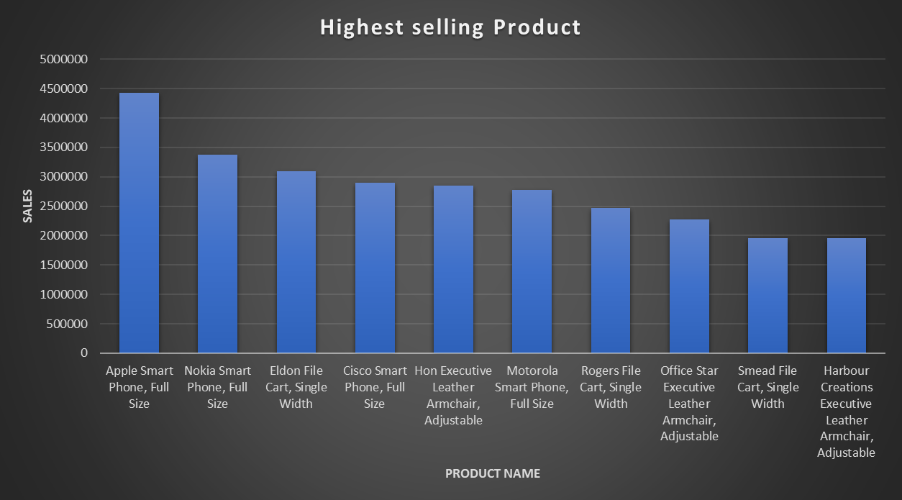
Title Page
Reporters
Introduction
Highest selling

Slide 11
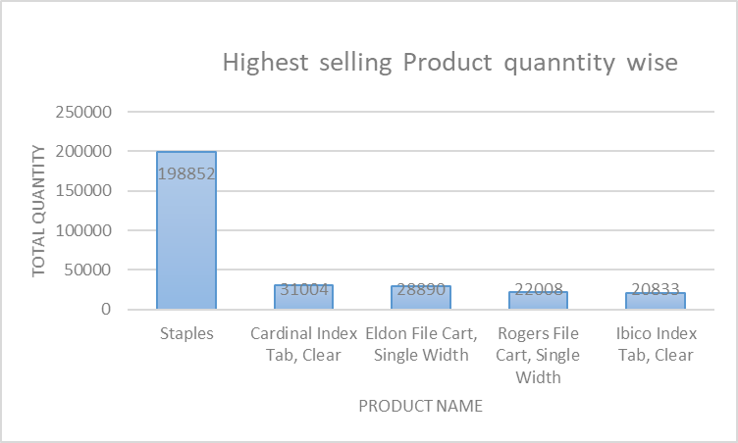
Title Page
Reporters
Introduction
Quantity highest sale
Almost 45% of total quantity sold is
Staples out of all the top orders

Slide 12
SALES ANALYSIS
Category and Sub-catagory

Slide 13
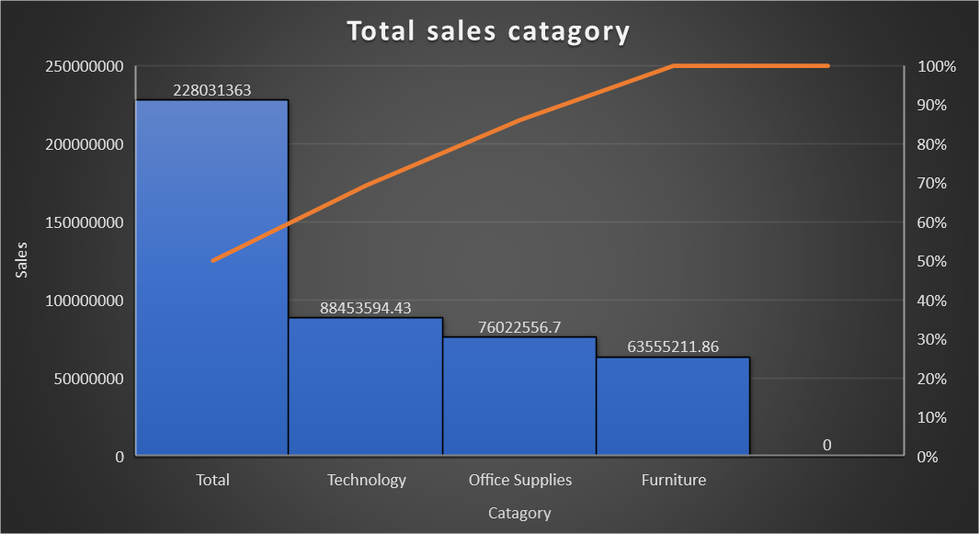
Title Page
Reporters
Introduction
Catagory

Slide 14
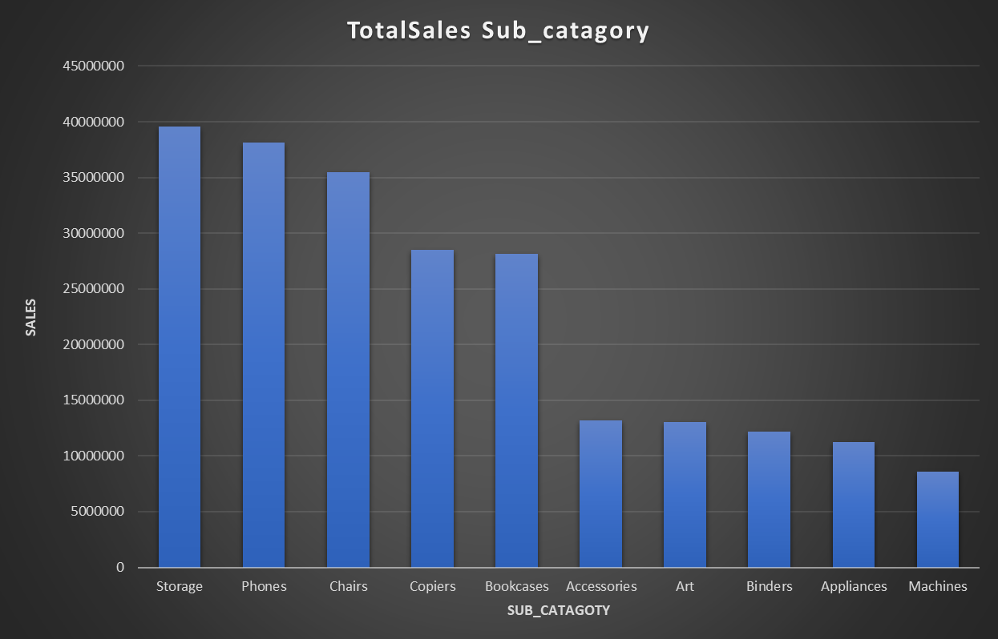
Title Page
Reporters
Introduction
Sub_catagory

Slide 15
SALES ANALYSIS
Segment(Consumer/ Corporate)

Slide 16
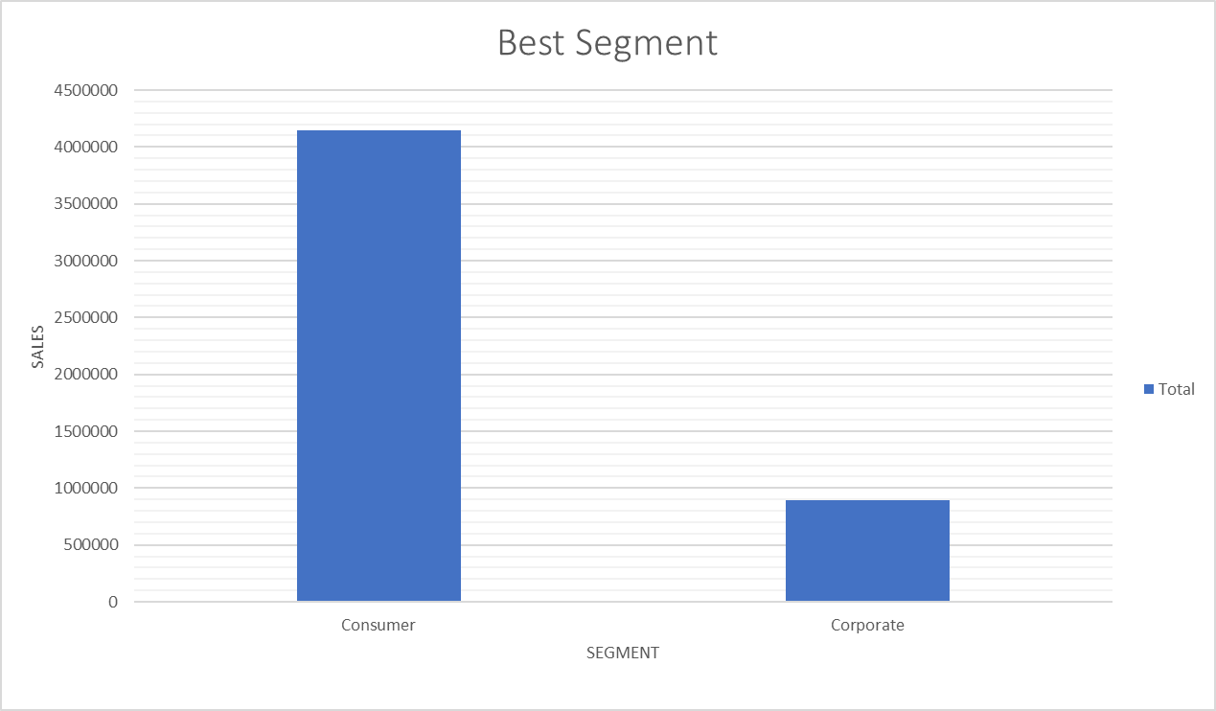
Title Page
Reporters
Introduction
Overview
Consumer
Corporate
Home Office

Slide 17
SALES ANALYSIS
Region and Country

Slide 18
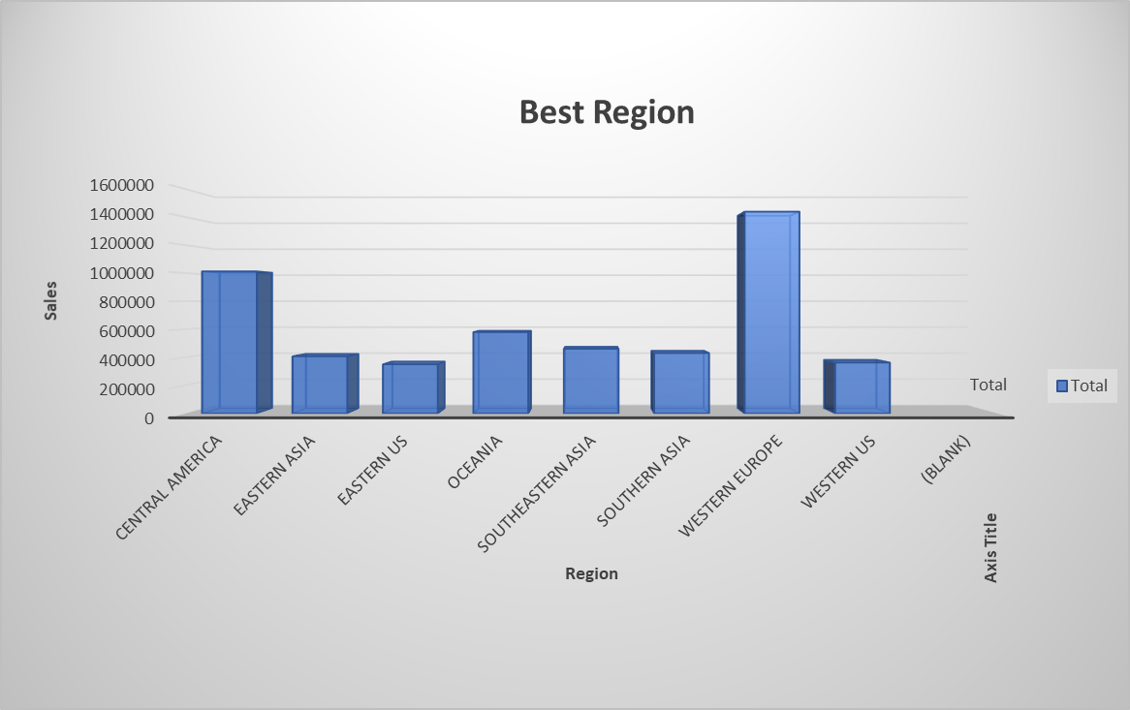
Title Page
Reporters
Introduction
Best Region

Slide 19
PROFITABILITY AND COST
Profit Margin(Best)

Slide 20
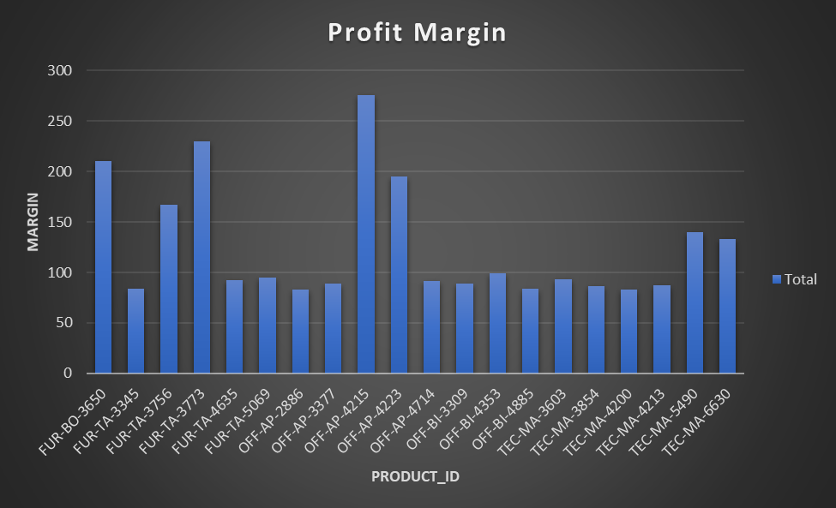
Title Page
Reporters
Introduction
Overview
OFF-AP-4215 = Disposable Bags

Slide 21
CUSTOMER BEHAVIOR
Order Priority

Slide 22
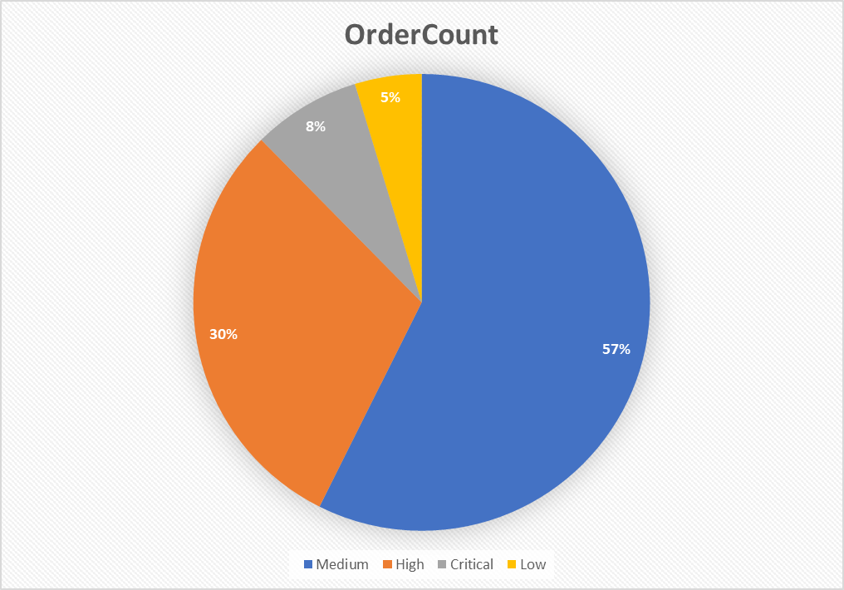
Title Page
Reporters
Introduction
Order Count

Slide 23
CUSTOMER BEHAVIOR
Best Segment Customer

Slide 24
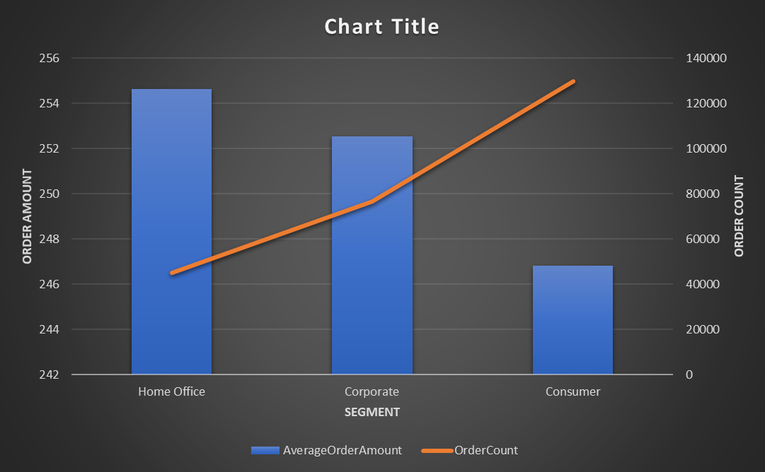

Slide 25
ORDER MANAGEMENT
Best Shipping Mode

Slide 26
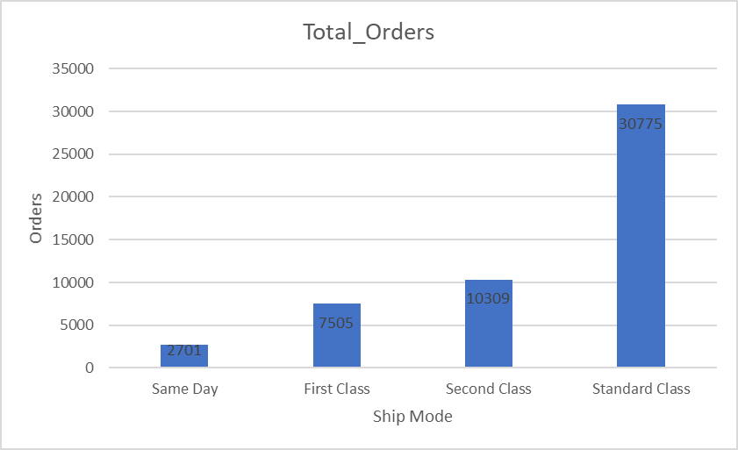
Title Page
Reporters
Introduction
Ship wise order

Slide 27
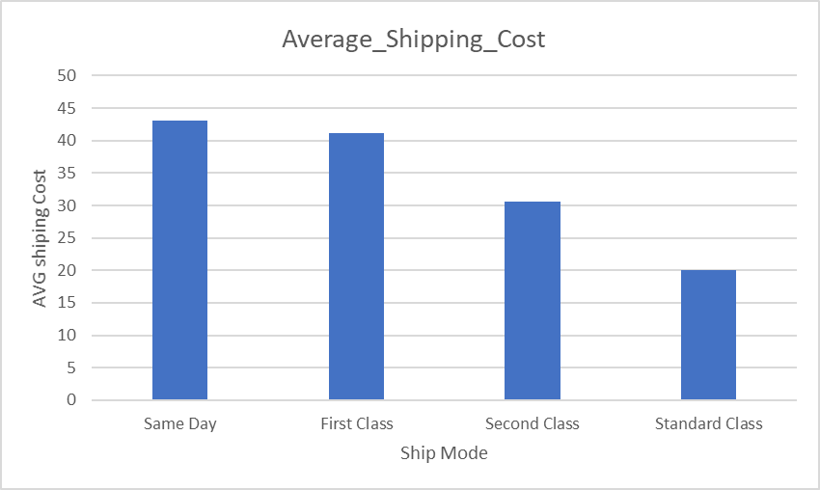
Title Page
Reporters
Introduction
Shiping Cost

Slide 28
GEOGRAPHICAL INSIGHTS
Best Regions and Countries

Slide 29
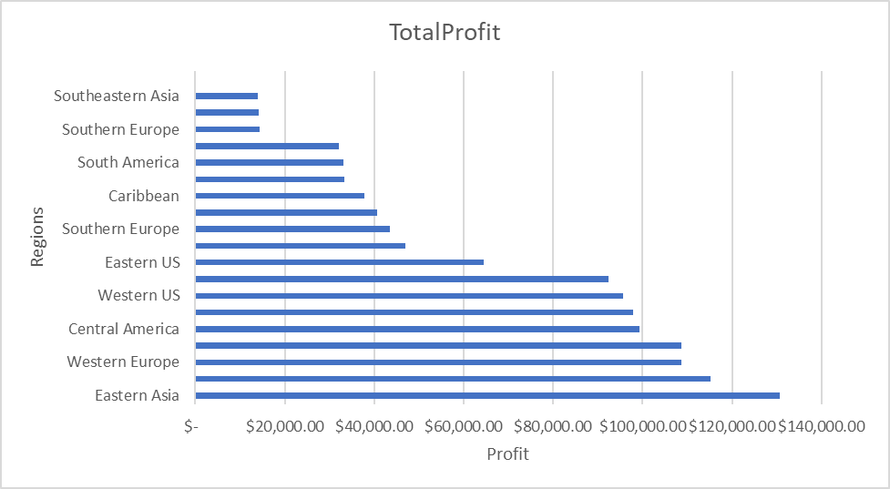
Title Page
Reporters
Introduction
Region's Profit

Slide 30
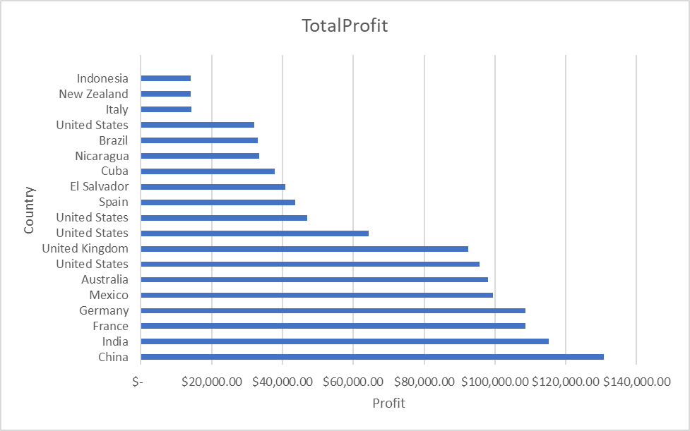
Title Page
Reporters
Introduction
Country's Profit

Slide 31
MARKET TRENDS
Seasonality

Slide 32
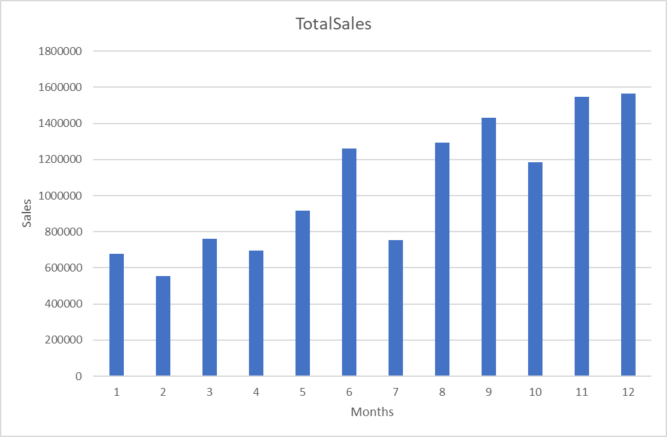
Title Page
Reporters
Introduction
Month Wise Sales

Slide 33




Title Page
Reporters
Introduction
Overview
Plan
Process
Recomendations
Recomendation
Recomendation
By implementing Some strategies, the global Store business can enhance its sales, profitability, and overall customer satisfaction.

Slide 34



Title Page
Reporters
Introduction
Overview
Plan
Recomendations
Recomendation
Focus on High-Demand Products:
Prioritize high-demand products like "Staples" to meet customer needs promptly.
Optimize Top-Selling Categories:
Optimize marketing for top-selling categories to maximize revenue.

Slide 35

Title Page
Reporters
Introduction
Recomendations
Recomendation
03
04
05
06
SEGMENT AND REGIONAL STRATEGIES:
MAXIMIZE PROFITABLE PRODUCTS:
CUSTOMER-CENTRIC APPROACH:
STRATEGIC DISCOUNTS:
Tailor strategies for high-performing segments in specific regions.
Focus on profitable products while re-evaluating those with negative margins.
Prioritize preferred shipping modes for efficient customer service.
Adjust discount strategies for a balanced approach to attracting customers.

Slide 36




Title Page
Reporters
Introduction
Overview
Plan
Recomendations
Recomendation
RECOMENDATIONS
Utilize seasonal trends for targeted marketing and inventory management.
Capitalize on emerging growth trends in specific regions.
SEASONAL PLANNING
MARKET TREND ANALYSIS

Slide 37

CONTINUOUS MONITORING AND ADAPTATION:
GROWTH
Maintain data-driven decision-making and adapt strategies in real-time.

Slide 38


Title Page
Reporters
Introduction
Overview
Plan
Process
Conclusion
THE END
Any Question
Question?

